Slide 1
How to Become A TOT Certified Trainer

Slide 2
National Skill Development Corporation
NSDC aims to promote skill development by catalyzing creation of large, quality and for-profit vocational institutions. Further, the organization provides funding to build scalable and profitable vocational training initiatives.

Slide 3
Sector Skill Councils
SSCs are the main pillars of NSDC that plays a vital role in bridging the gap between What the industry demands and What the skilling requirements ought to be.
SSCs give the National Occupational Standards that contribute to the Skilling Industry. NSDC helps SSC with funds to grow and regulate their working.

Slide 4
Role of SSCs
Identification of Skill Development Needs.
Determining Skills/competency standards and Qualifications.
Developing and Maintaining Skills Inventory.
Standardization of Affiliation, Accreditation, Examination and Certification Process.
Plan and facilitate the execution of Training of Trainers along the NSDC and States.

Slide 5
Qualification Pack ( QP CODE)
A QP is a set of NOs aligned to various job roles. A QP is available for every job role in each industry sector. Thus National Skills Qualification Framework (NSQF) theoretically makes it possible to drive competency based training for each job role in each job sector. It states necessary qualifications and experience required in sector and teaching respectively.

Slide 6
How to Generate New Trainer ID on Skill India Portal

Slide 7
Visit SIP > Click Login

Slide 8
Click Register Now

Slide 9
Fill Details > Click Register

Slide 10
Enter OTP > Click Verify & Save

Slide 11
You will Receive TR ID and Password (on registered mail id) > Click Login Now

Slide 12
Reset your Password

Slide 14
How to Complete your Trainer Profile on Skill India Portal

Slide 15
Visit SIP > Click Login

Slide 16
Enter Credentials > Click Login

Slide 17
Fill Personal Details

Slide 18
Fill Contact & Address Details

Slide 19
Fill Education & Work Details

Slide 20
Fill all the Details > Click Save Changes

Slide 21
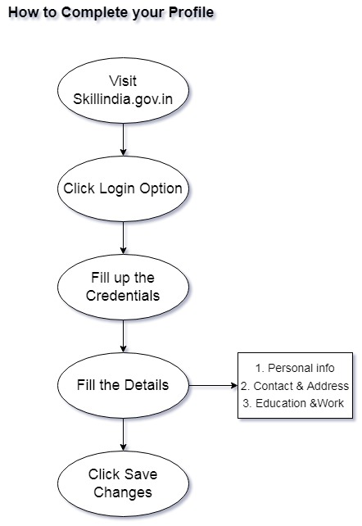

Slide 22
How to Add Training Request

Slide 23
Login your TR Profile > Click Search & Apply

Slide 24
Click Add Training Request

Slide 25
Fill the Details > Click Add Training Request

Slide 26
Steps after Training Request Applied
Complete the Payment Procedure
Give your Assessment on Scheduled Date
Check your Result
Apply for Certificate
Download your TOT Certificate from SIP

Slide 27
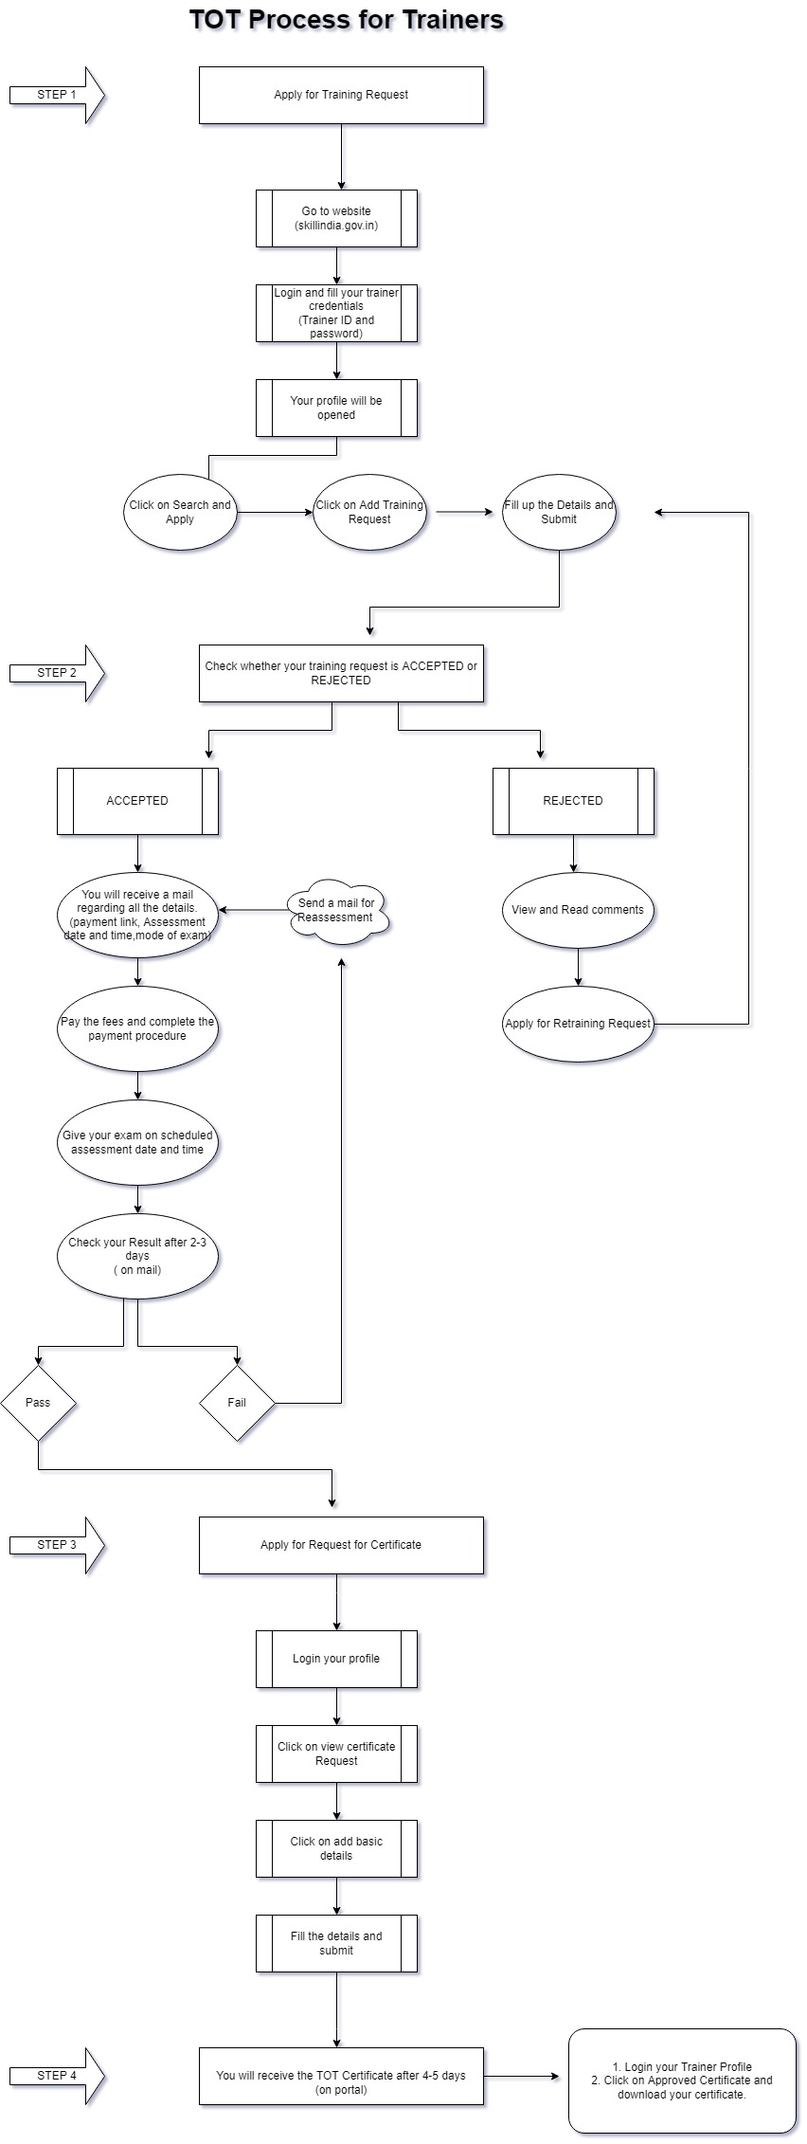

Slide 28
Thank You

